Slide 1
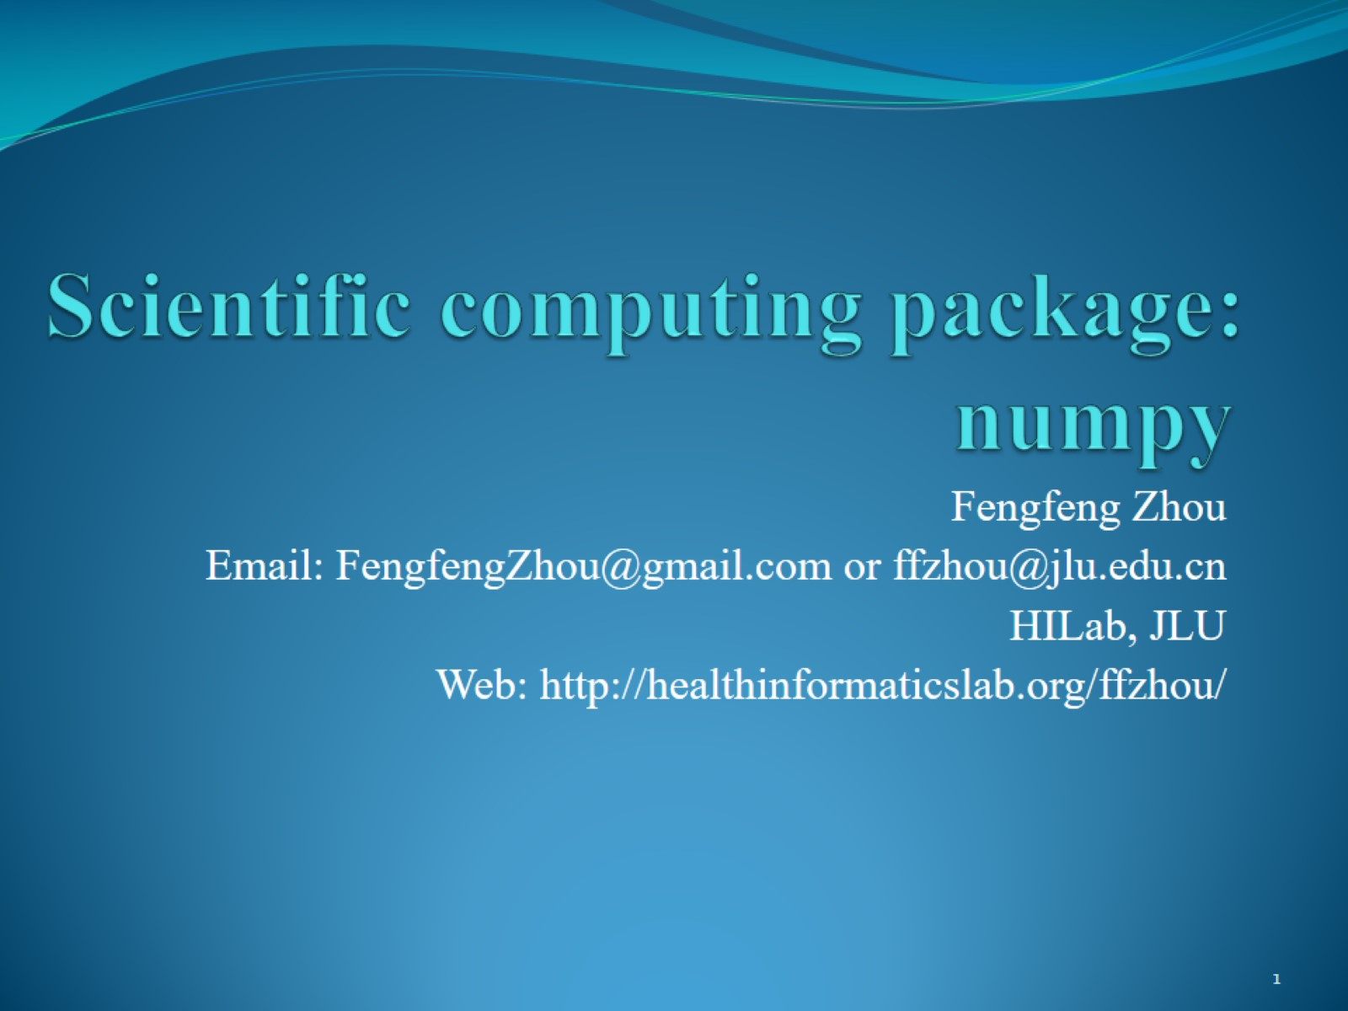
Scientific computing package: numpy

Slide 2
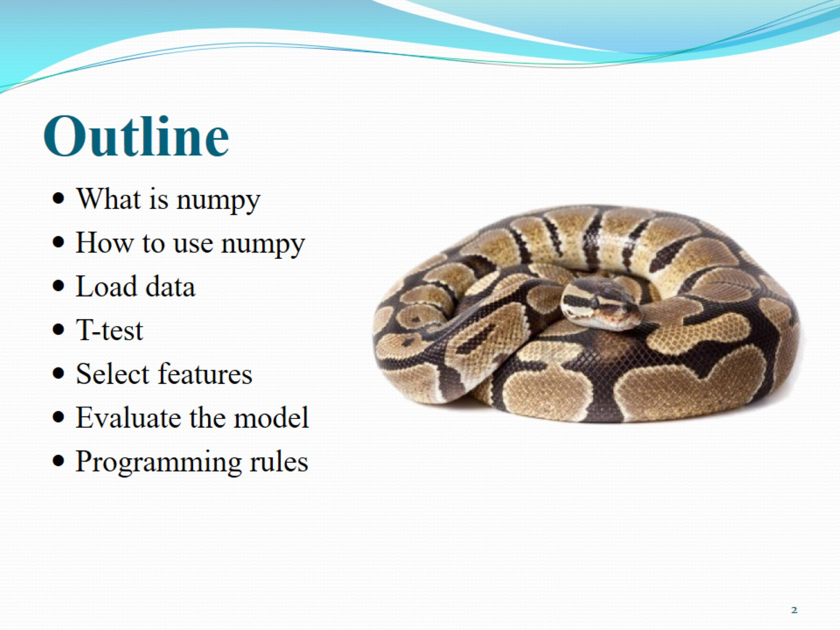
Outline

Slide 3
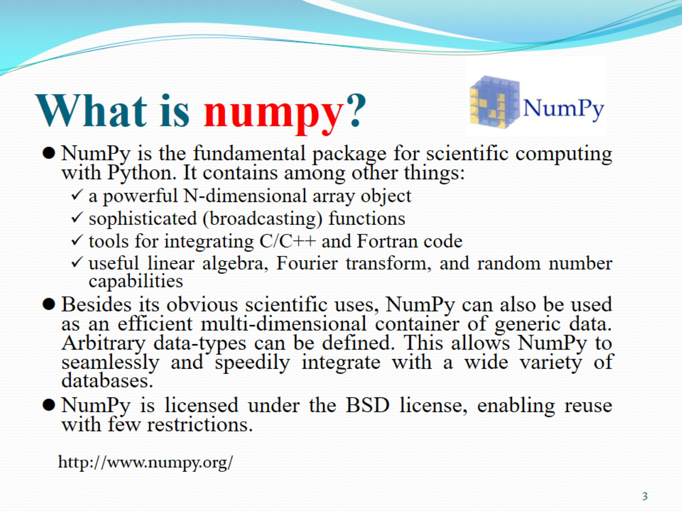
What is numpy?

Slide 4
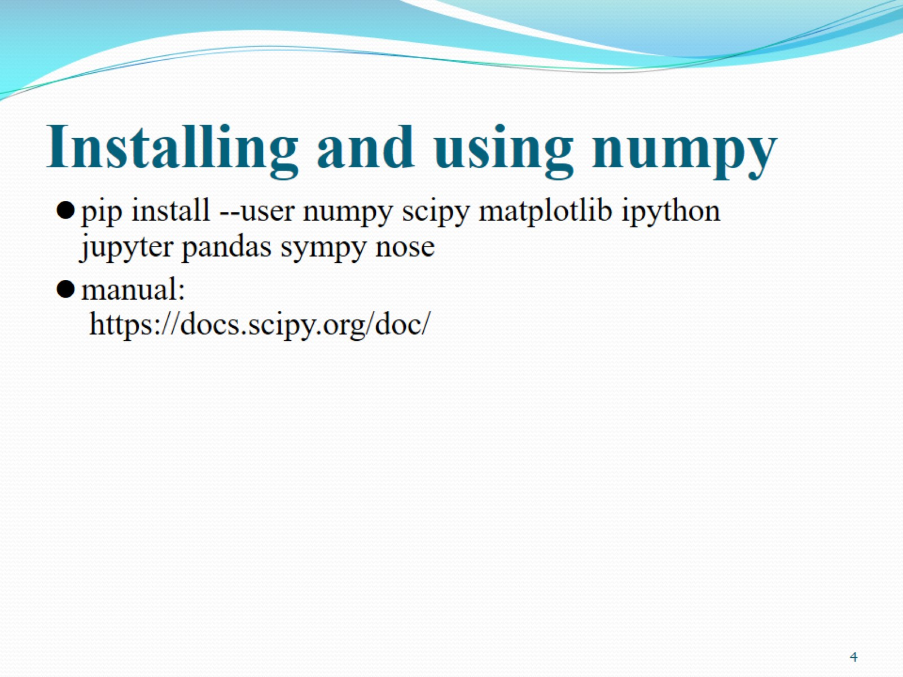
Installing and using numpy

Slide 5
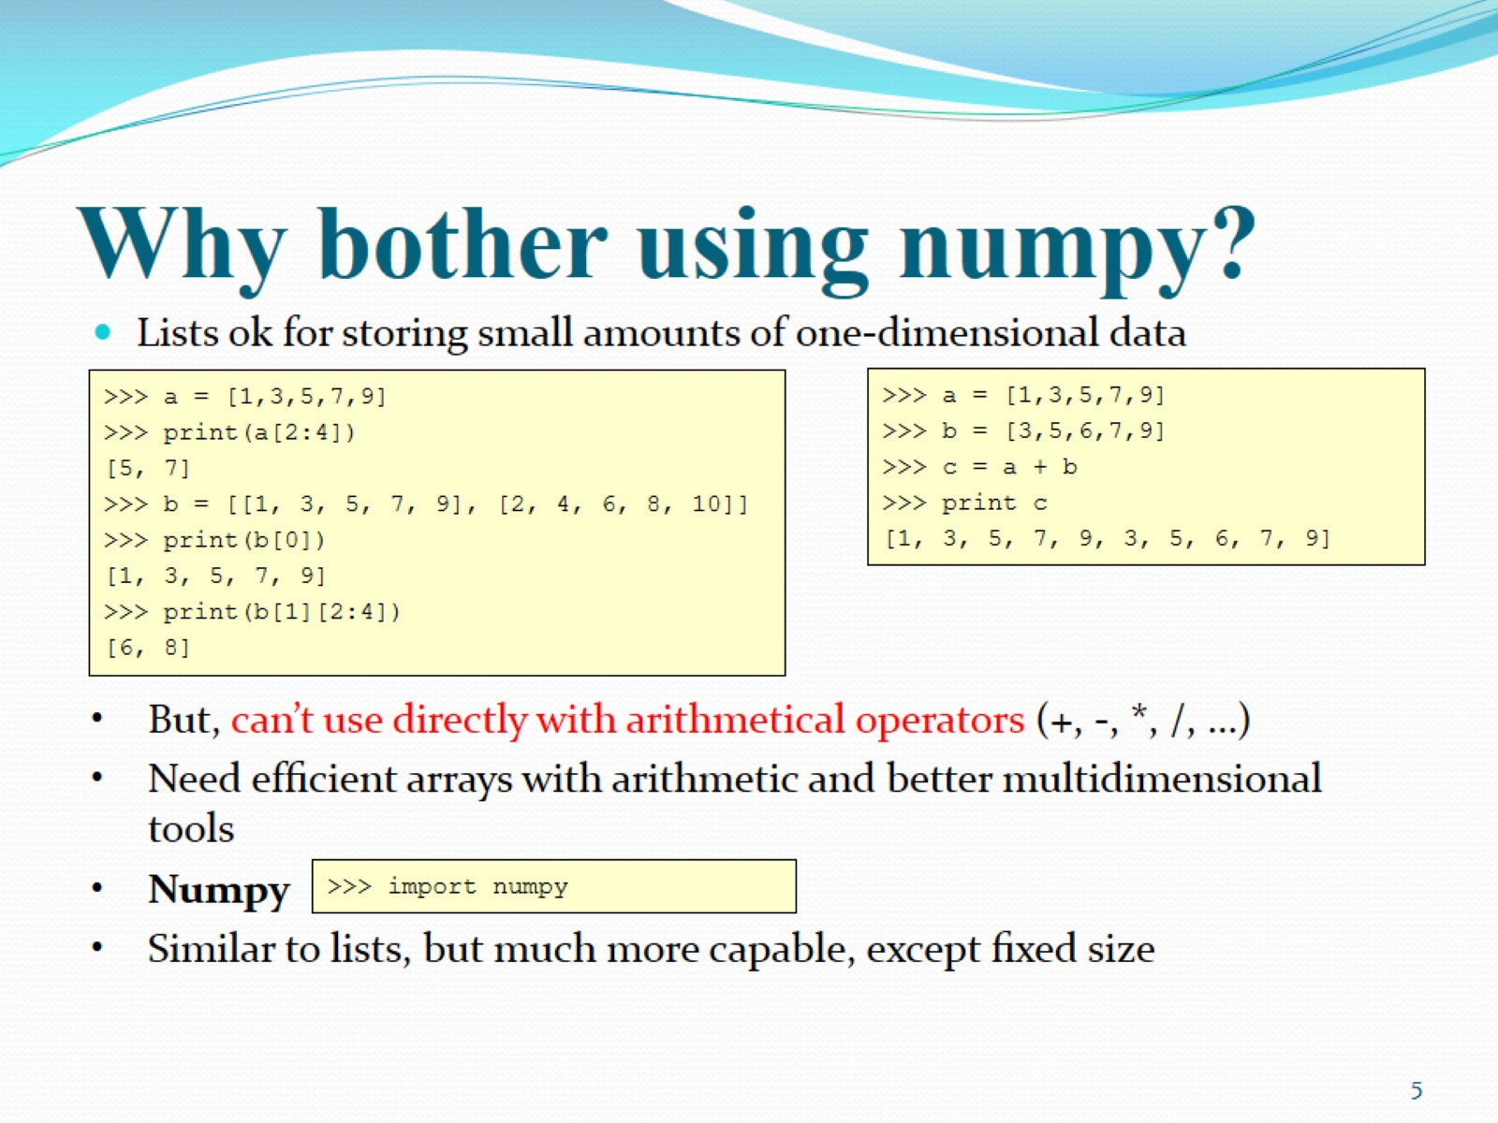
Why bother using numpy?

Slide 6
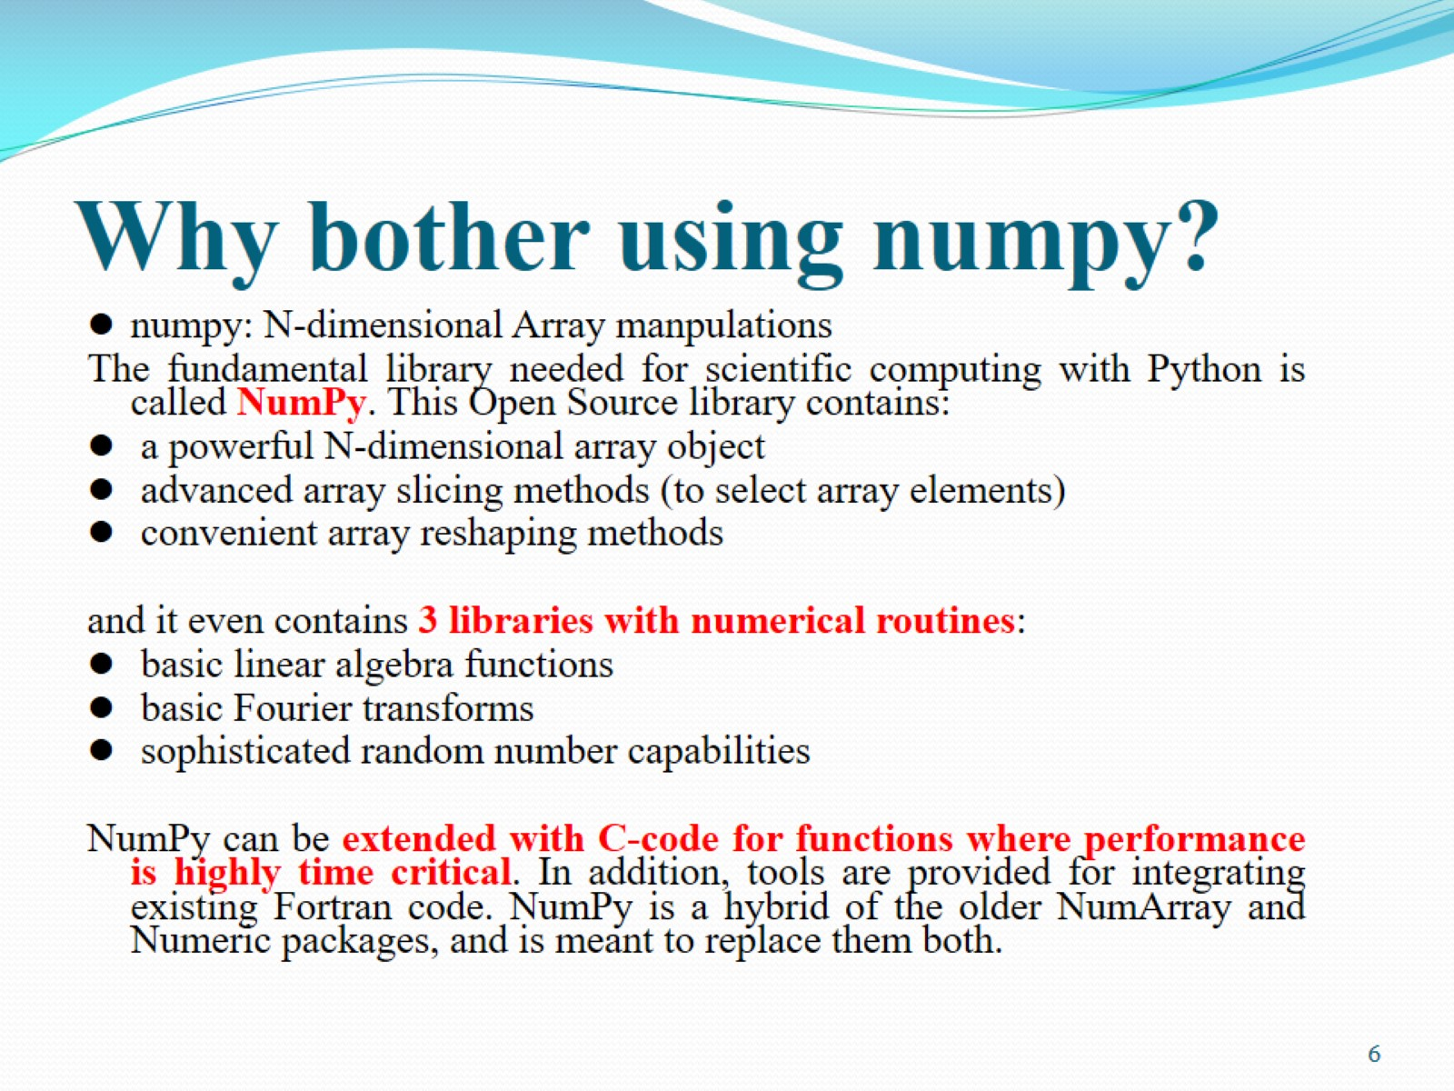
Why bother using numpy?

Slide 7

Outline

Slide 8
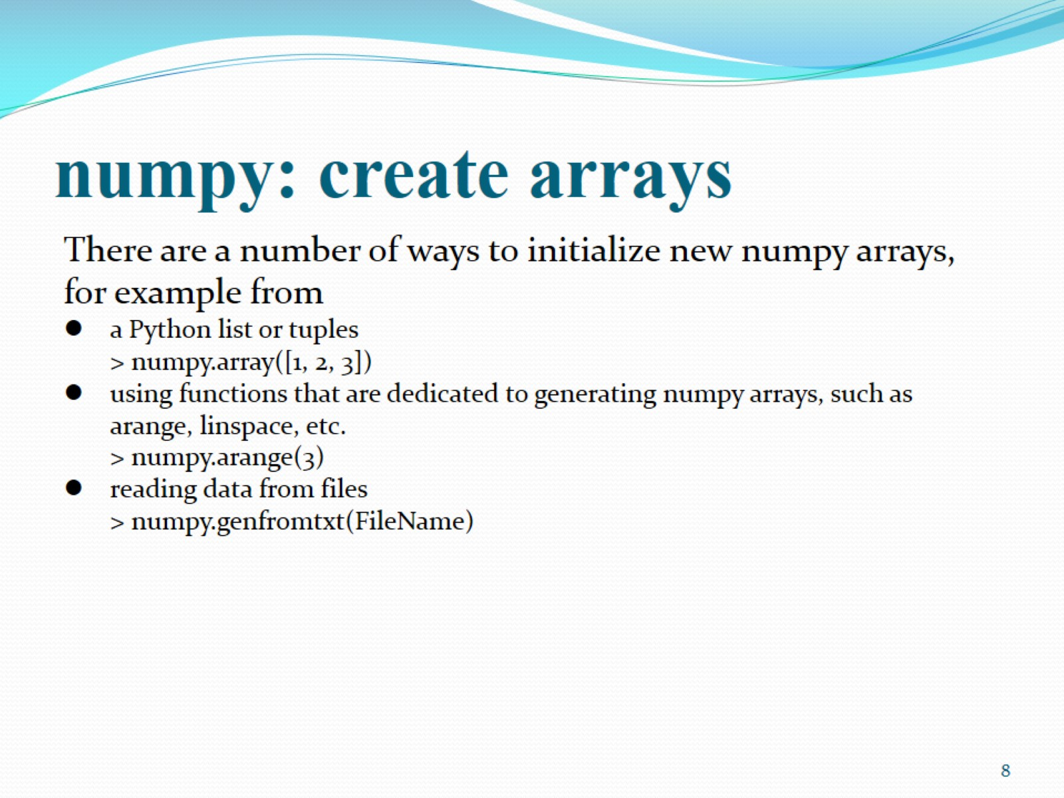
numpy: create arrays

Slide 9
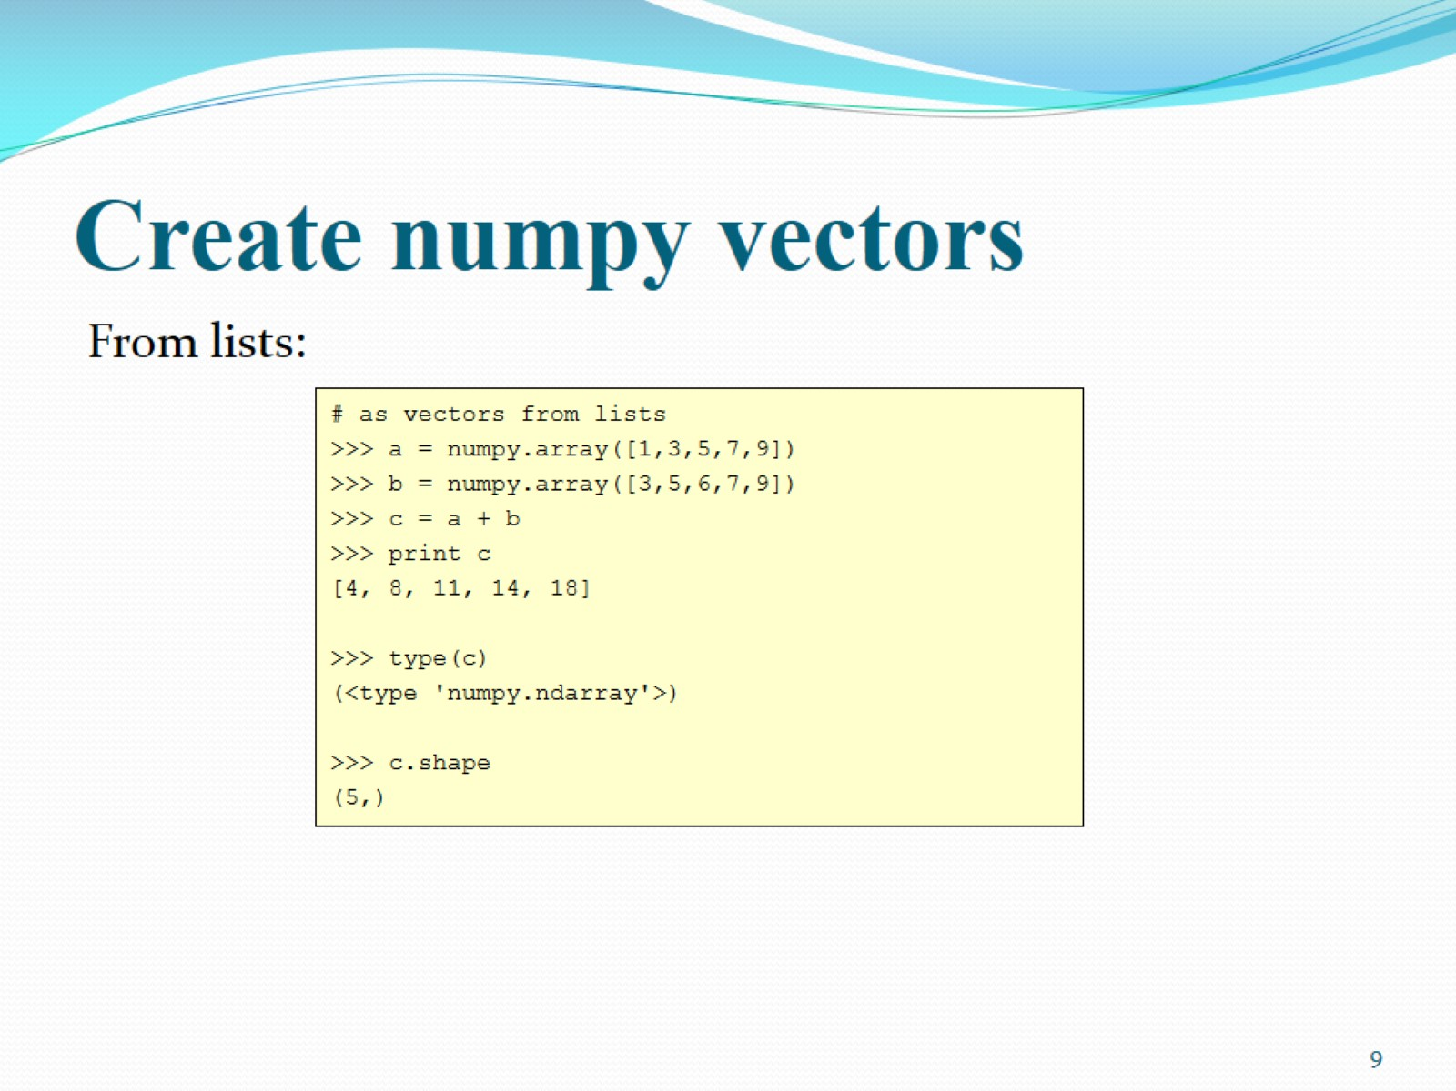
Create numpy vectors

Slide 10
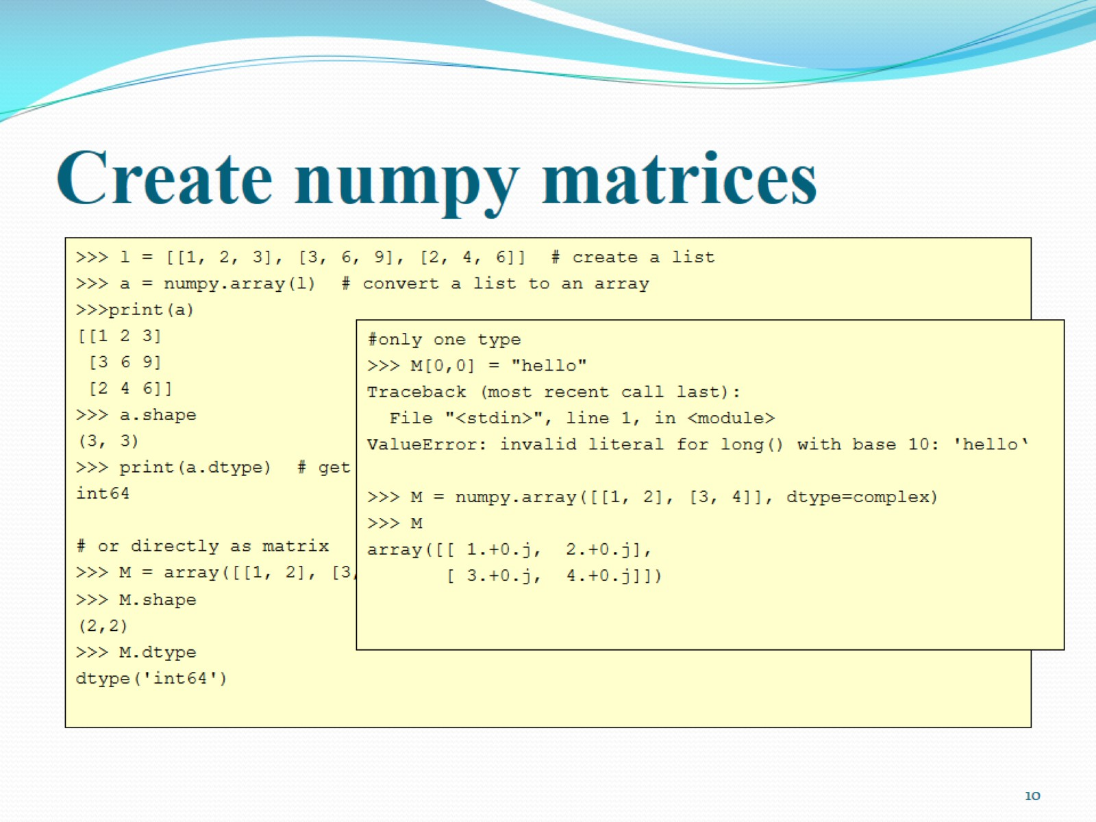
Create numpy matrices

Slide 11
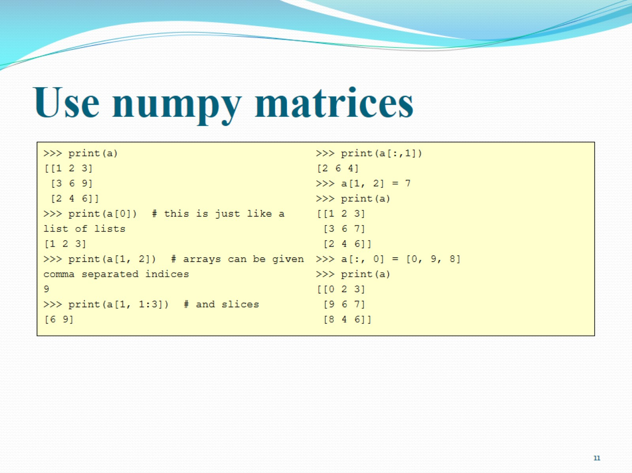
Use numpy matrices

Slide 12
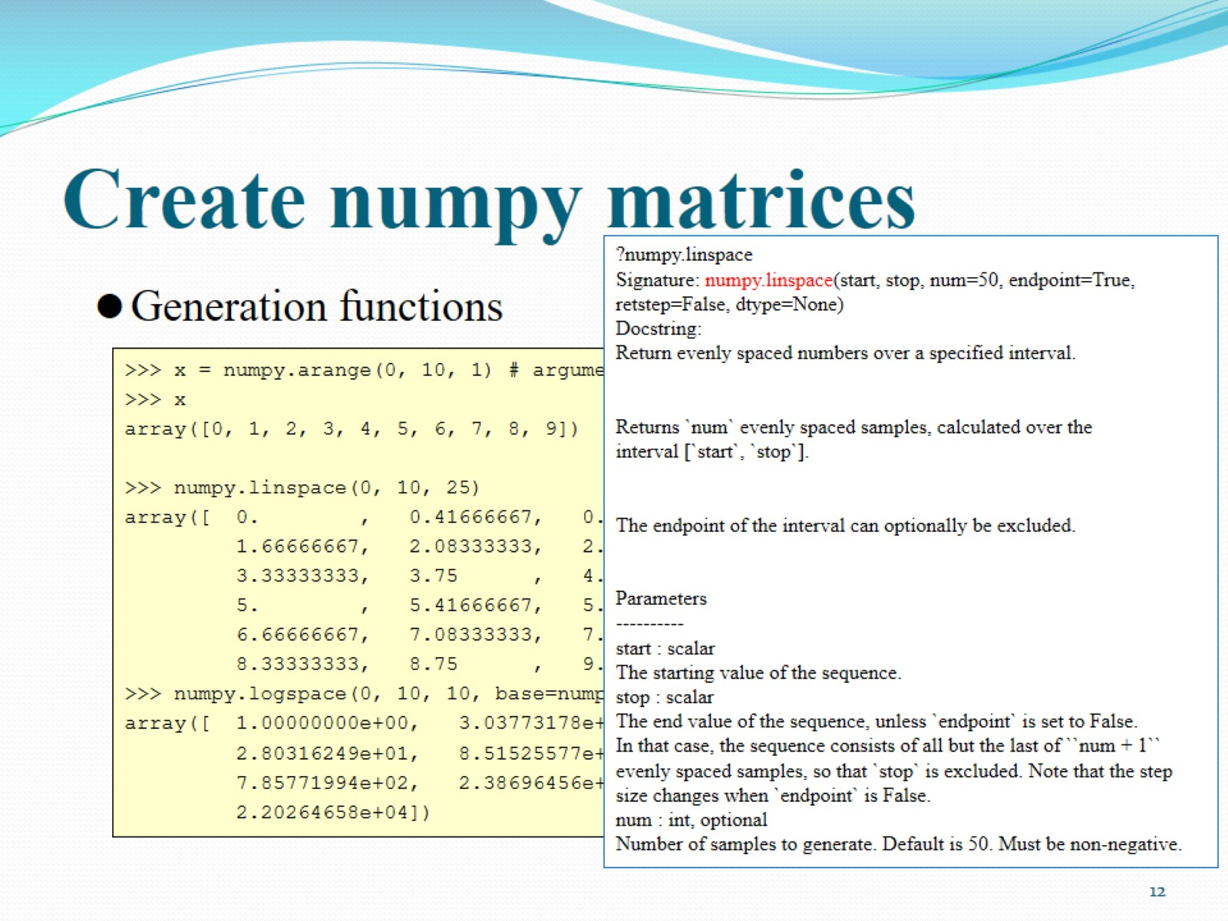
Create numpy matrices

Slide 13
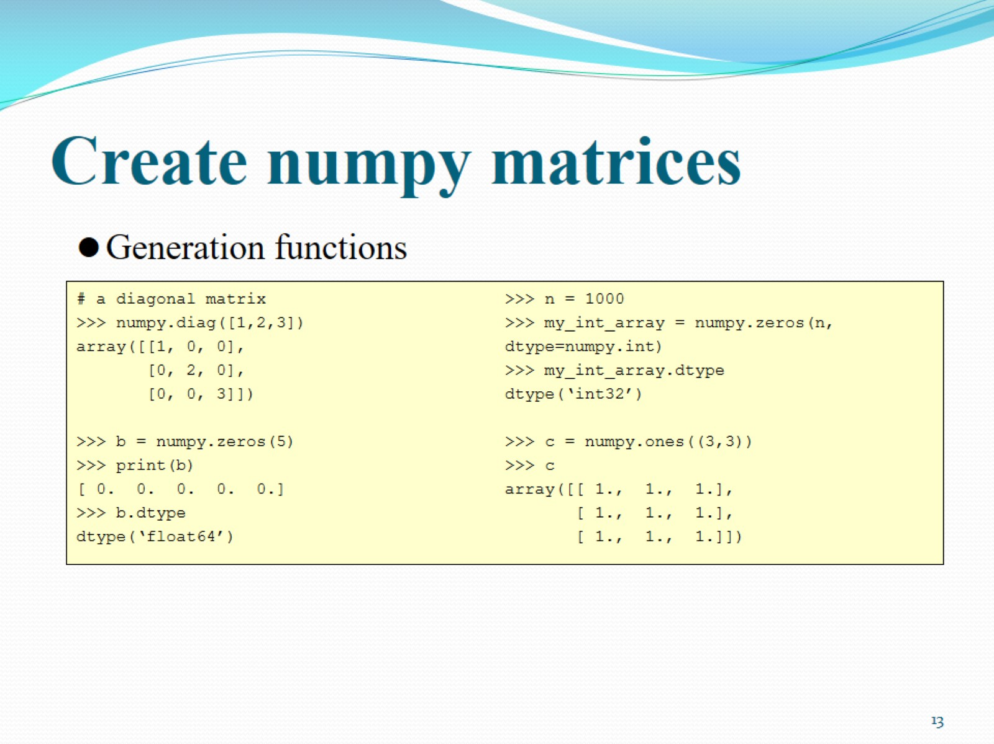
Create numpy matrices

Slide 14
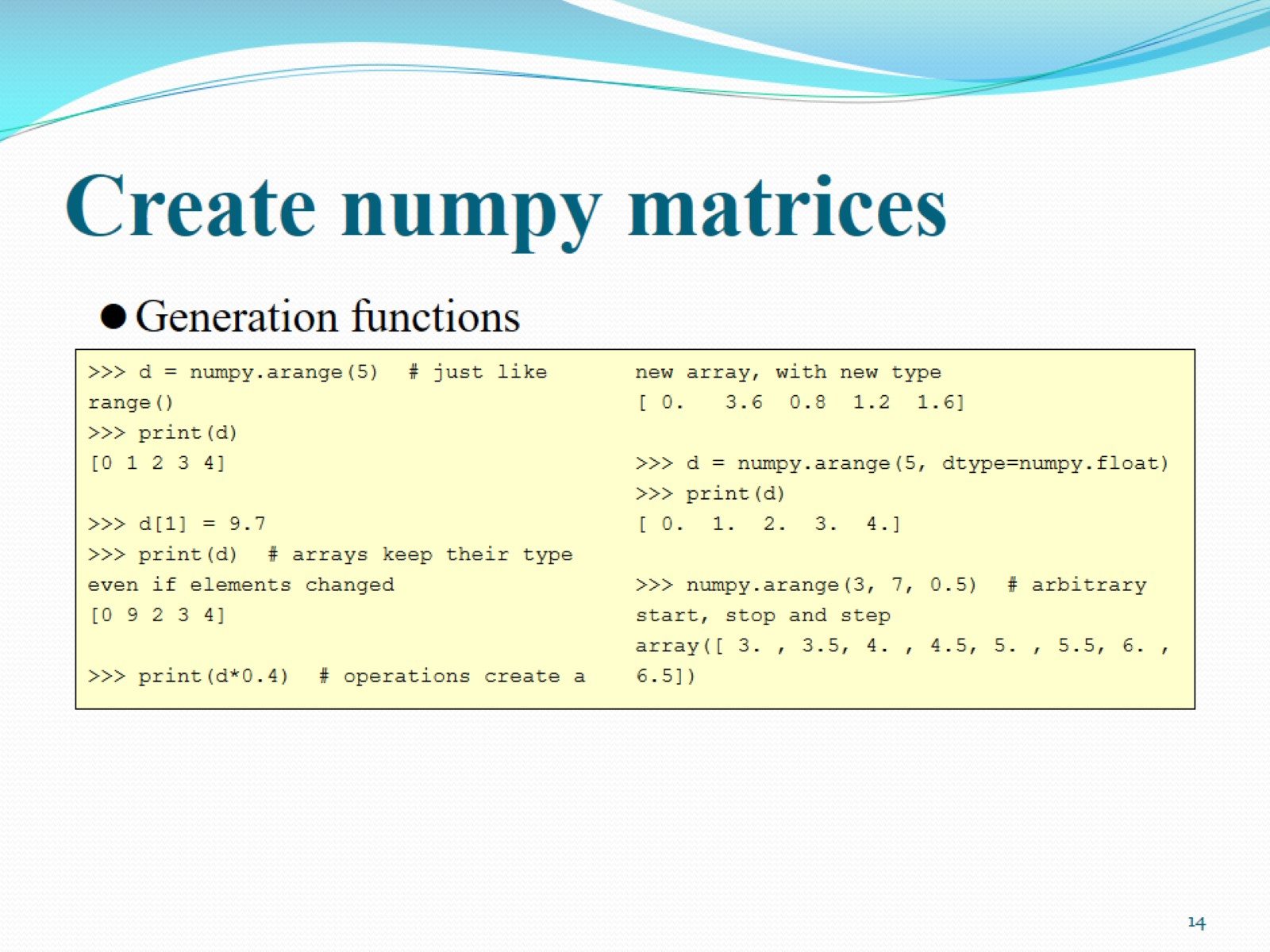
Create numpy matrices

Slide 15
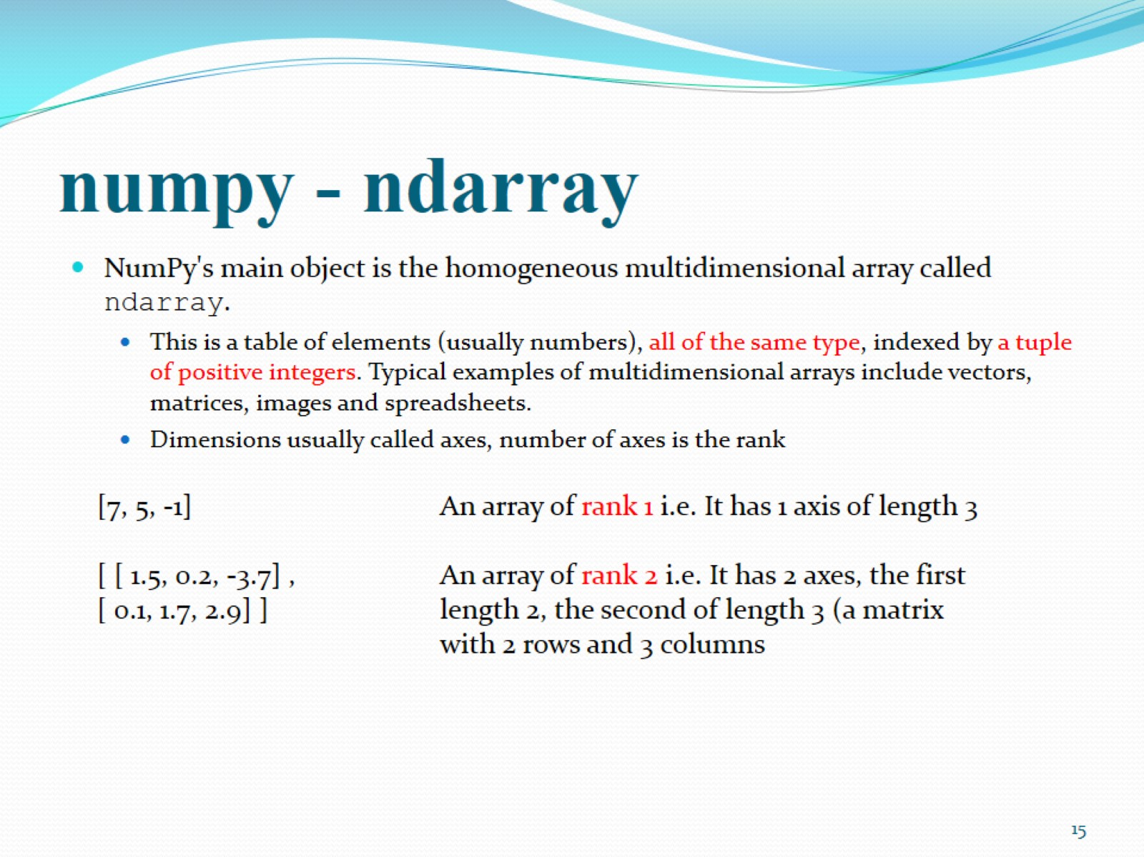
numpy - ndarray

Slide 16
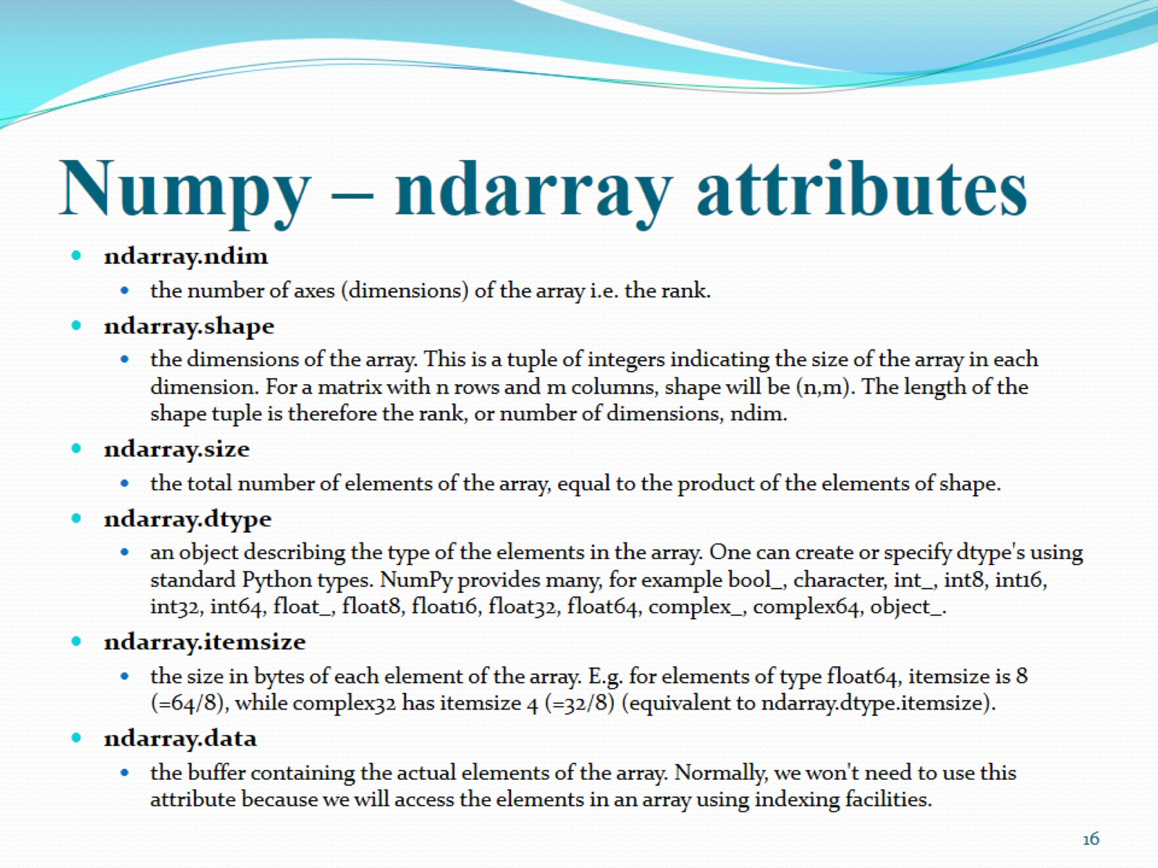
Numpy – ndarray attributes

Slide 17
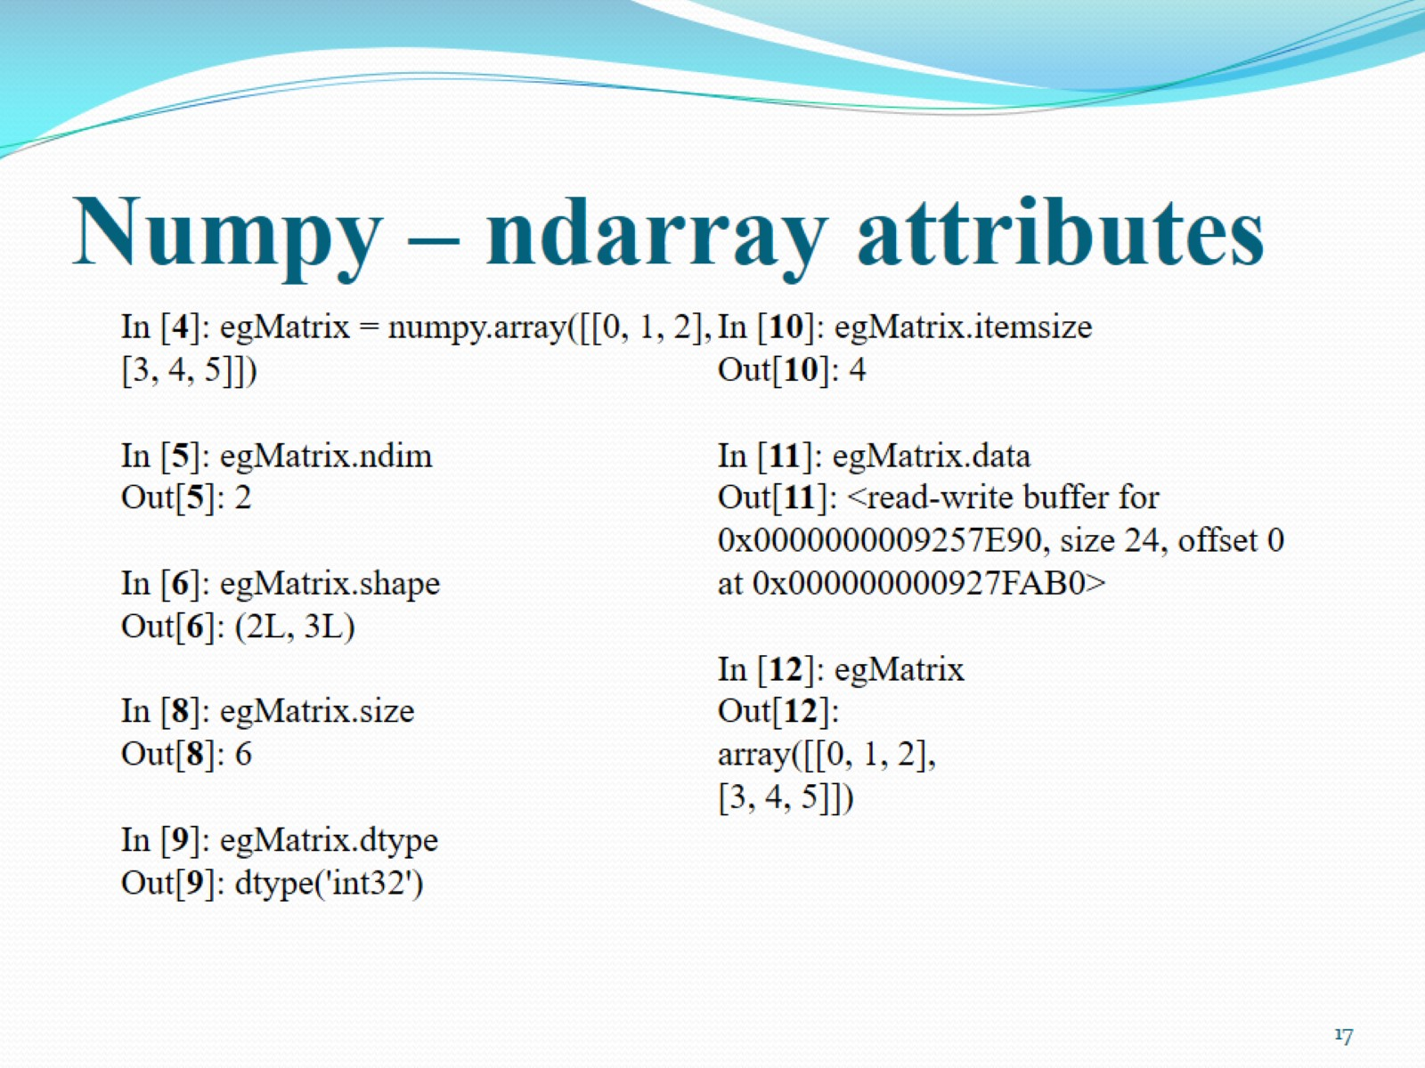
Numpy – ndarray attributes

Slide 18
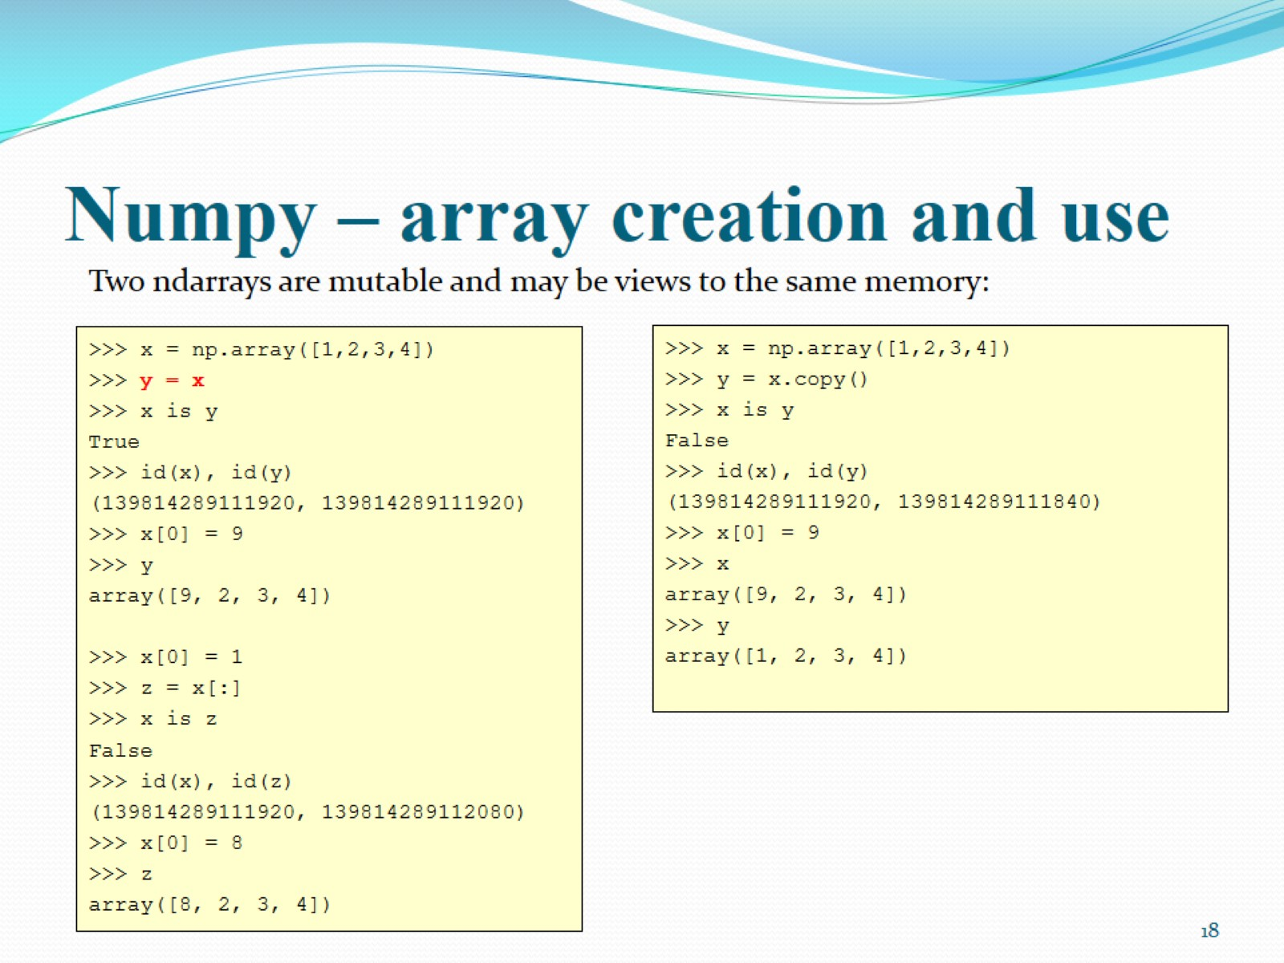
Numpy – array creation and use

Slide 19
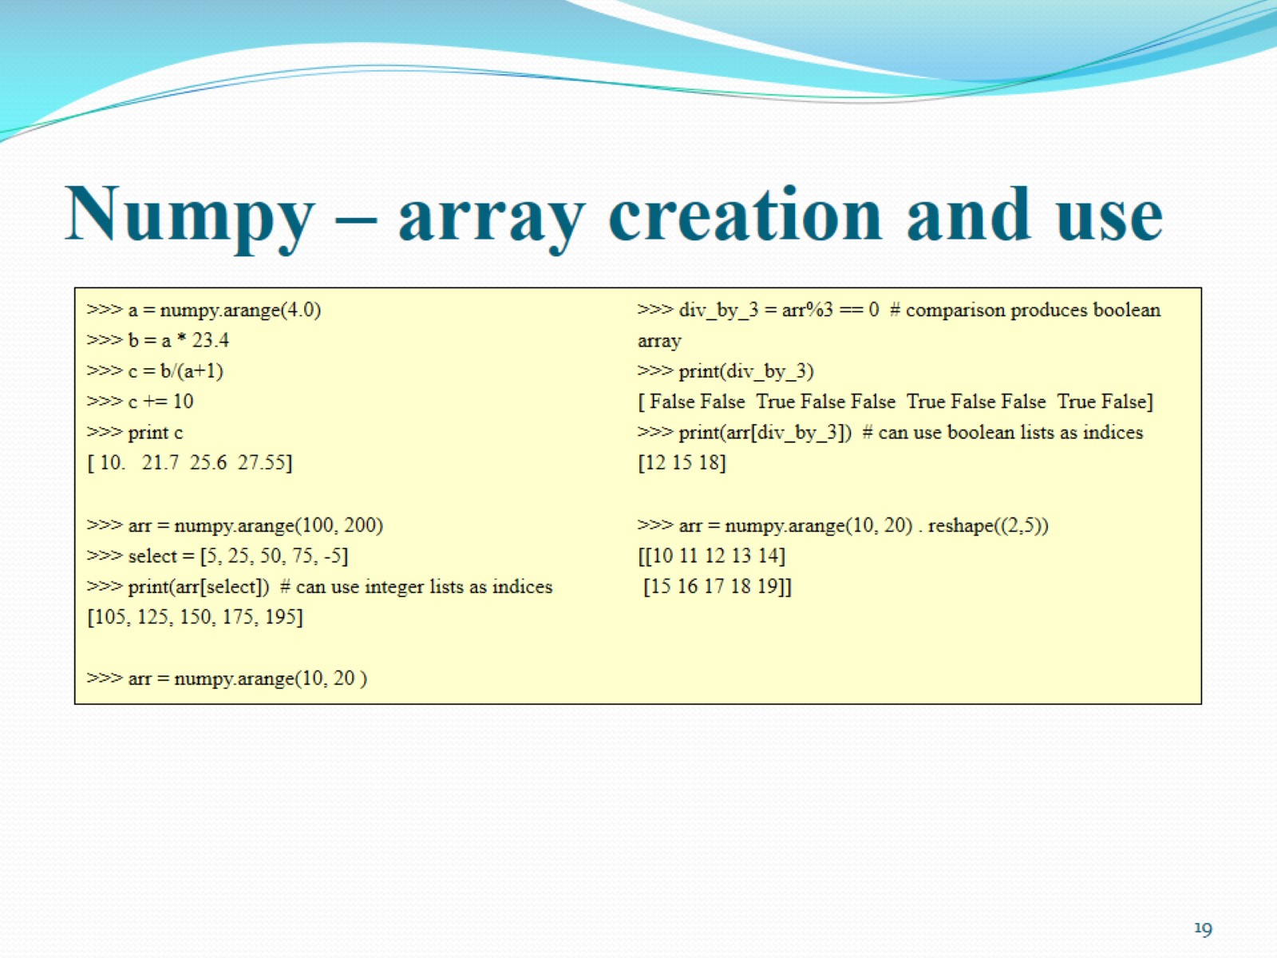
Numpy – array creation and use

Slide 20
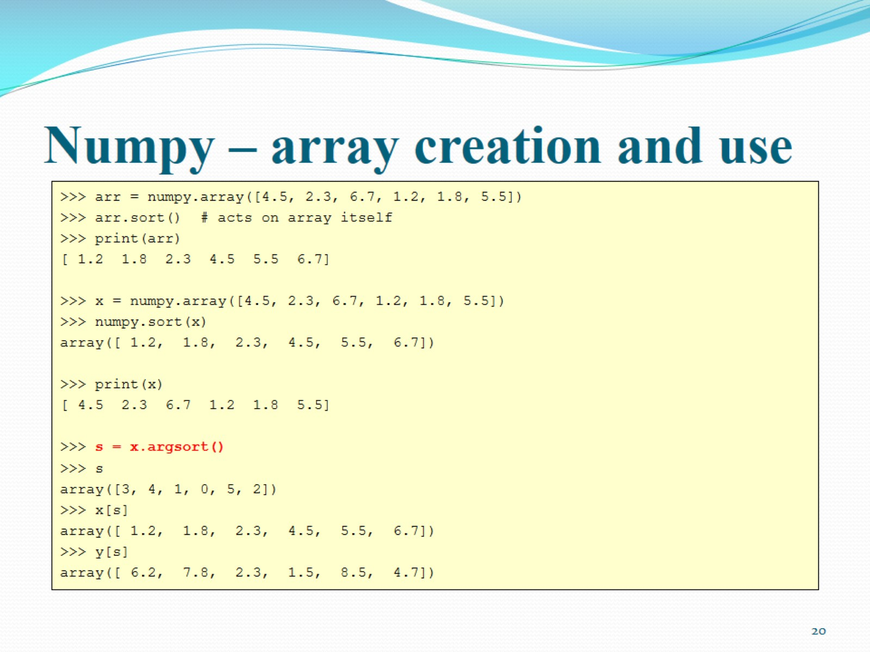
Numpy – array creation and use

Slide 21
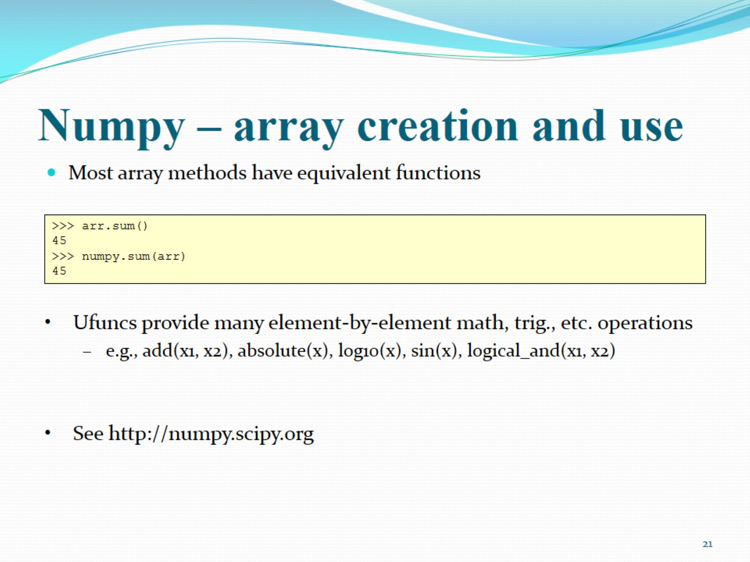
Numpy – array creation and use

Slide 22
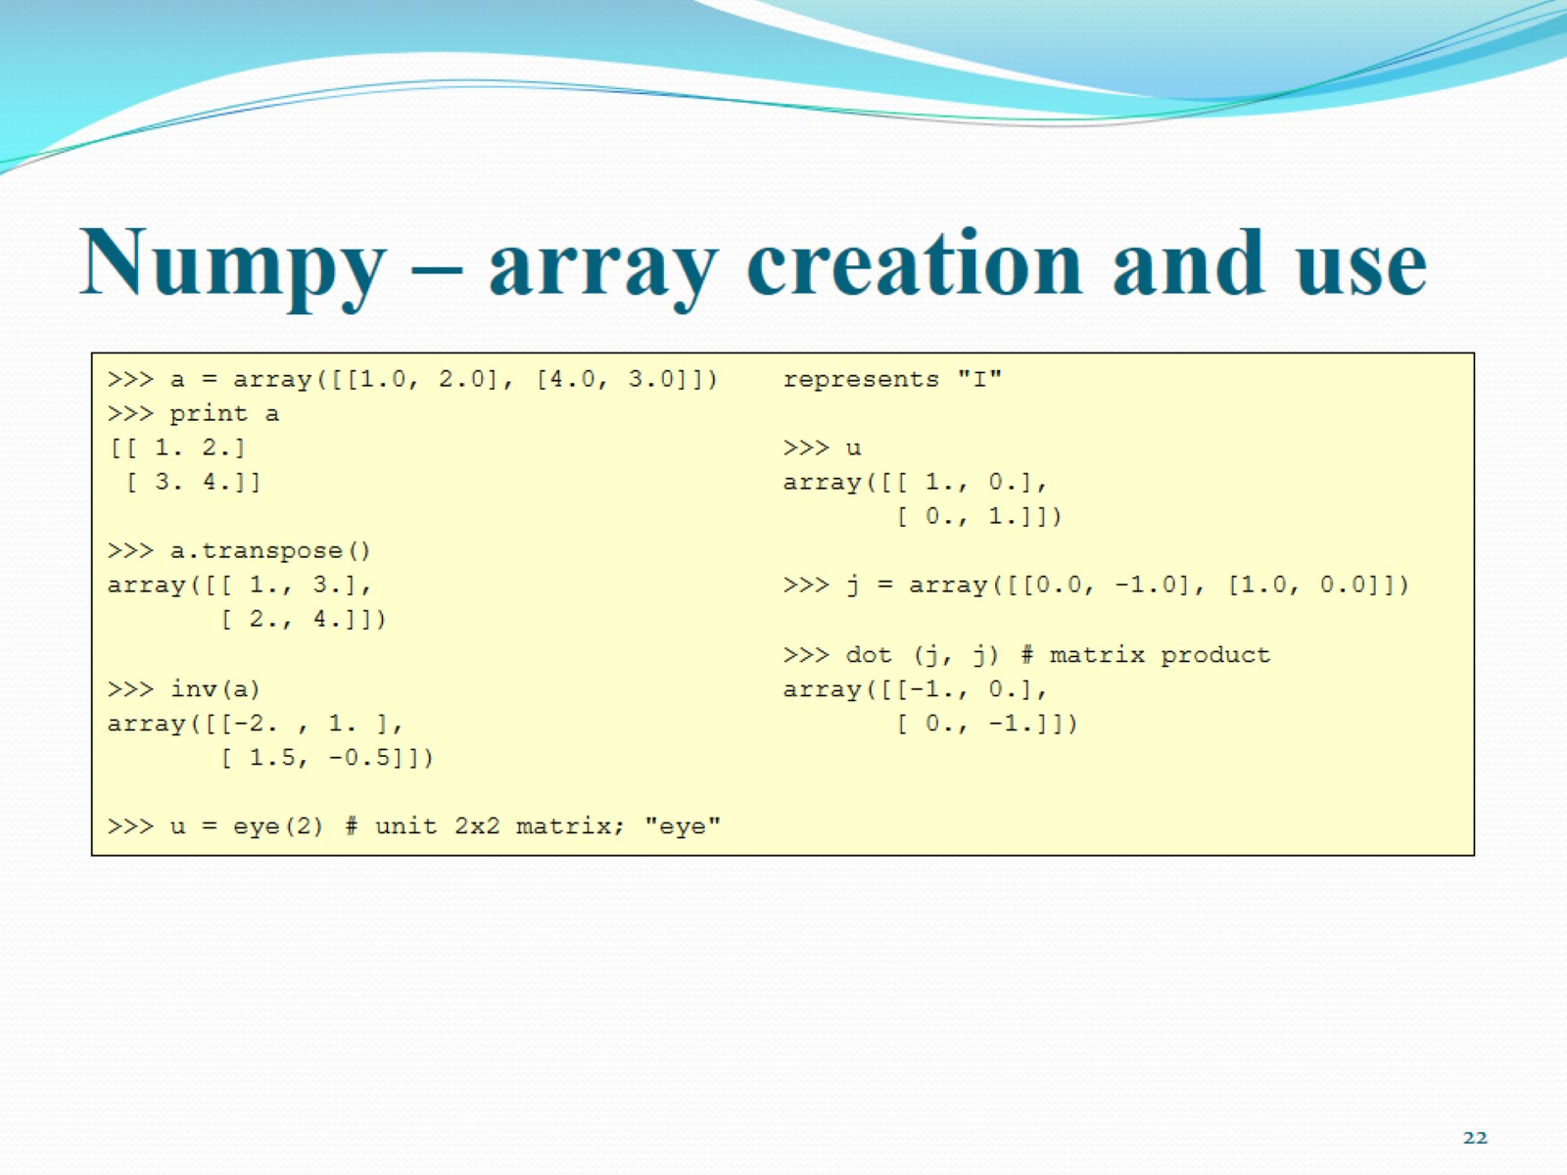
Numpy – array creation and use

Slide 23
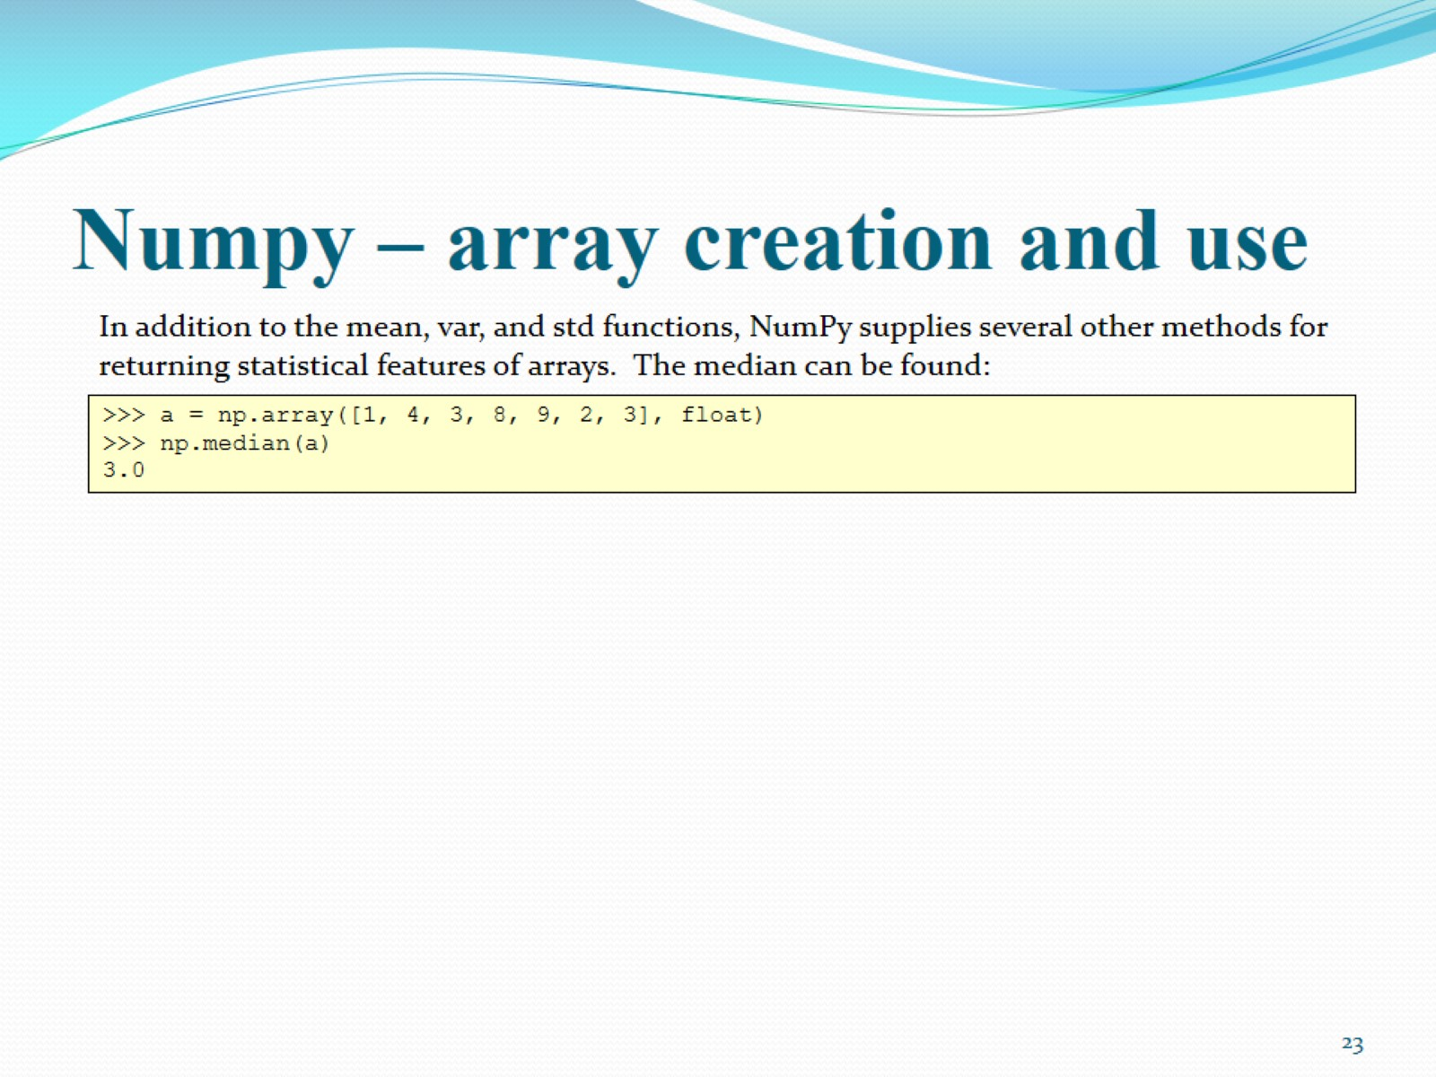
Numpy – array creation and use

Slide 24
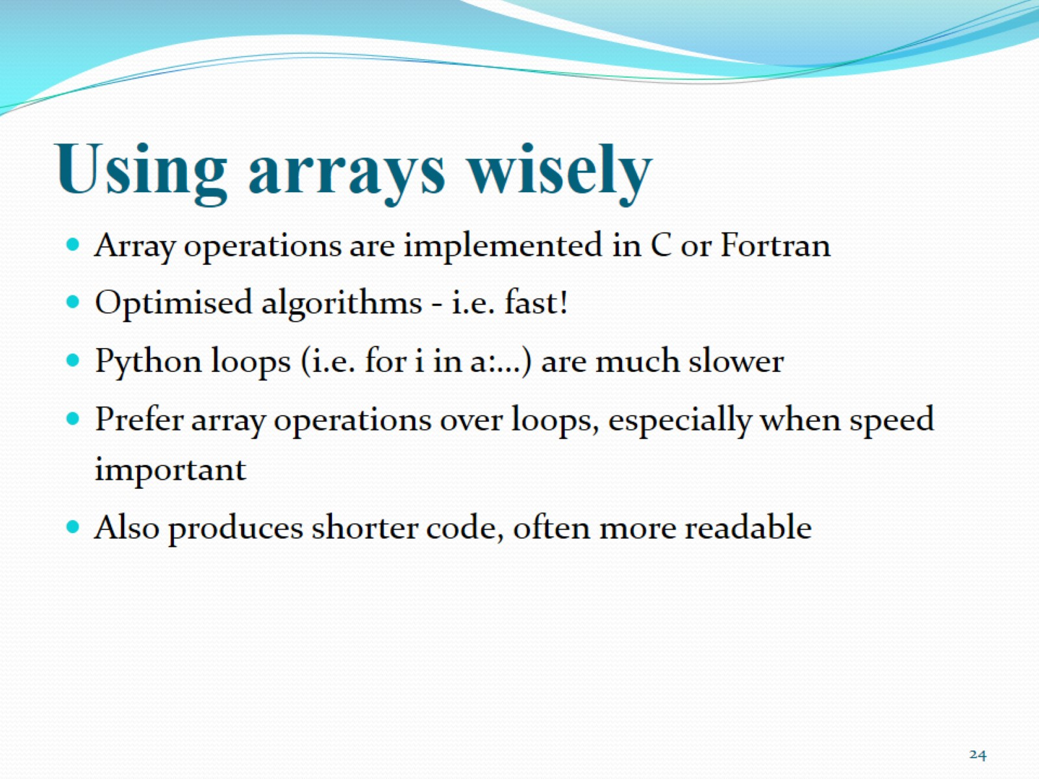
Using arrays wisely

Slide 25
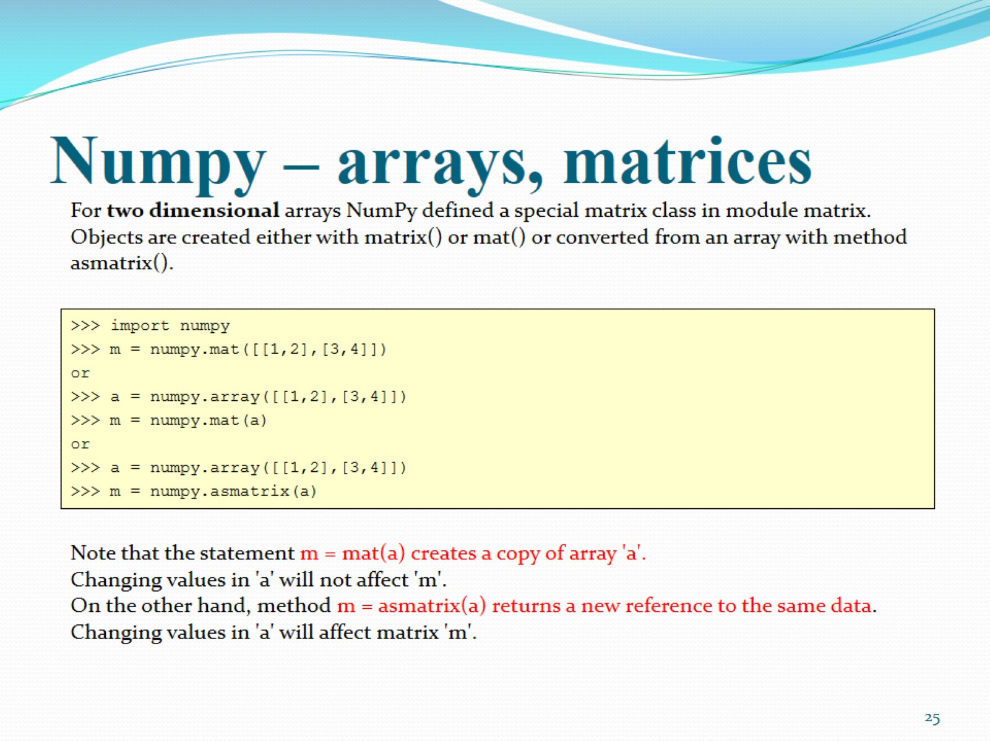
Numpy – arrays, matrices

Slide 26
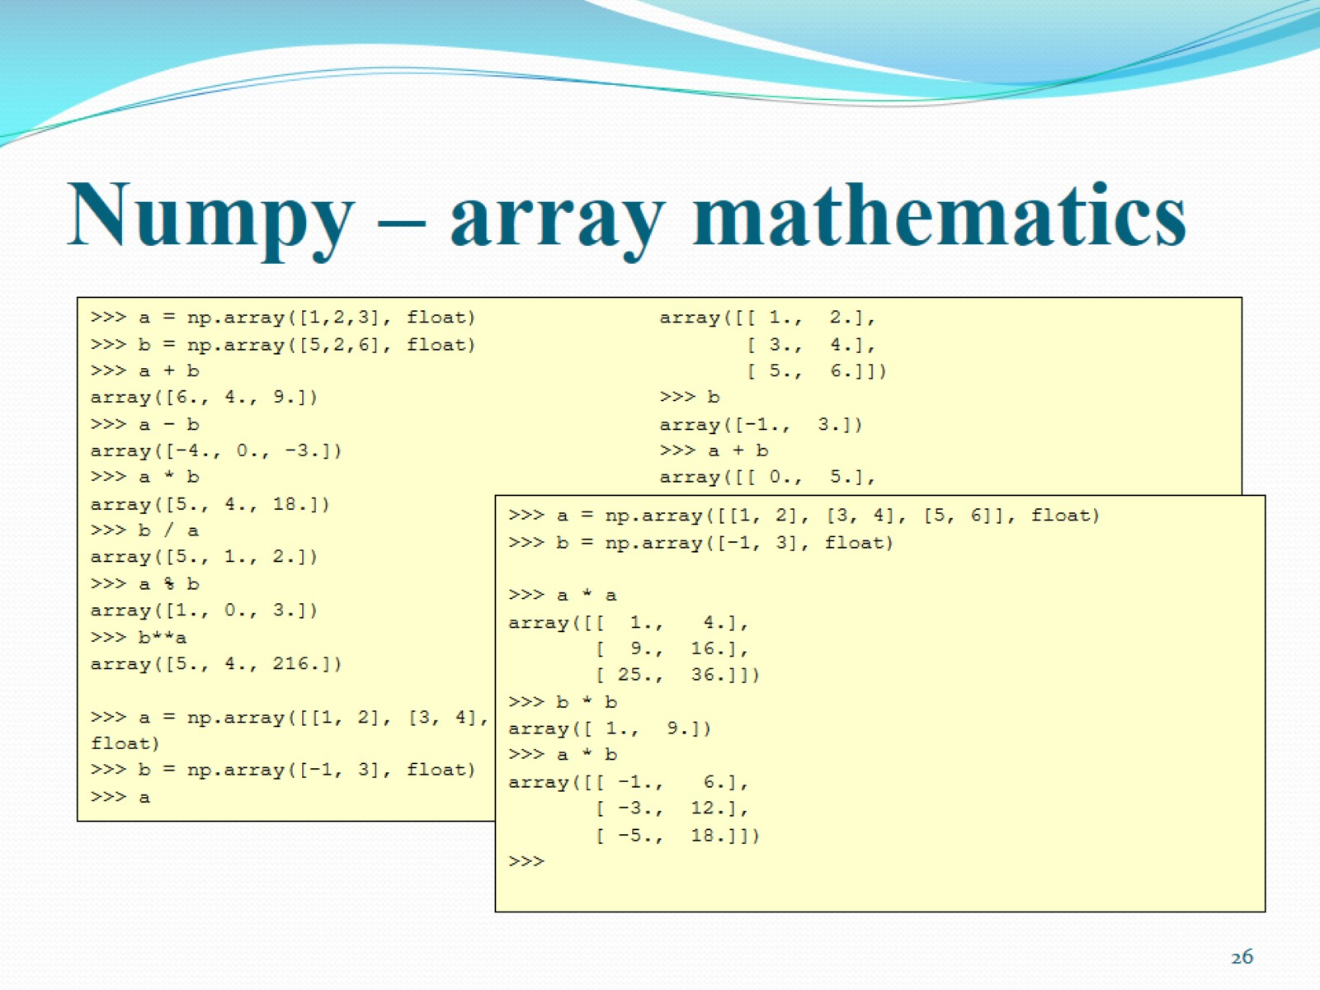
Numpy – array mathematics

Slide 27
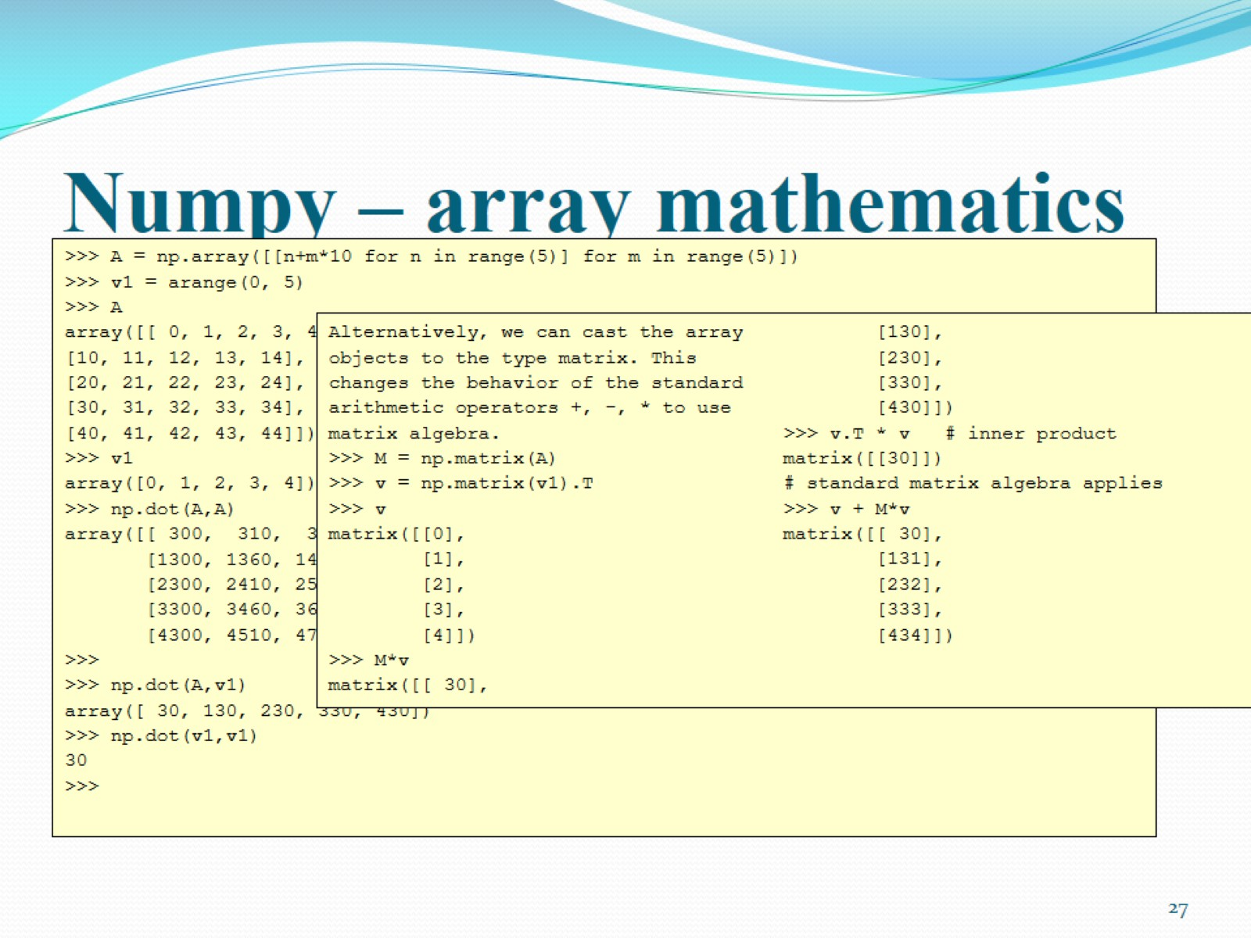
Numpy – array mathematics

Slide 28
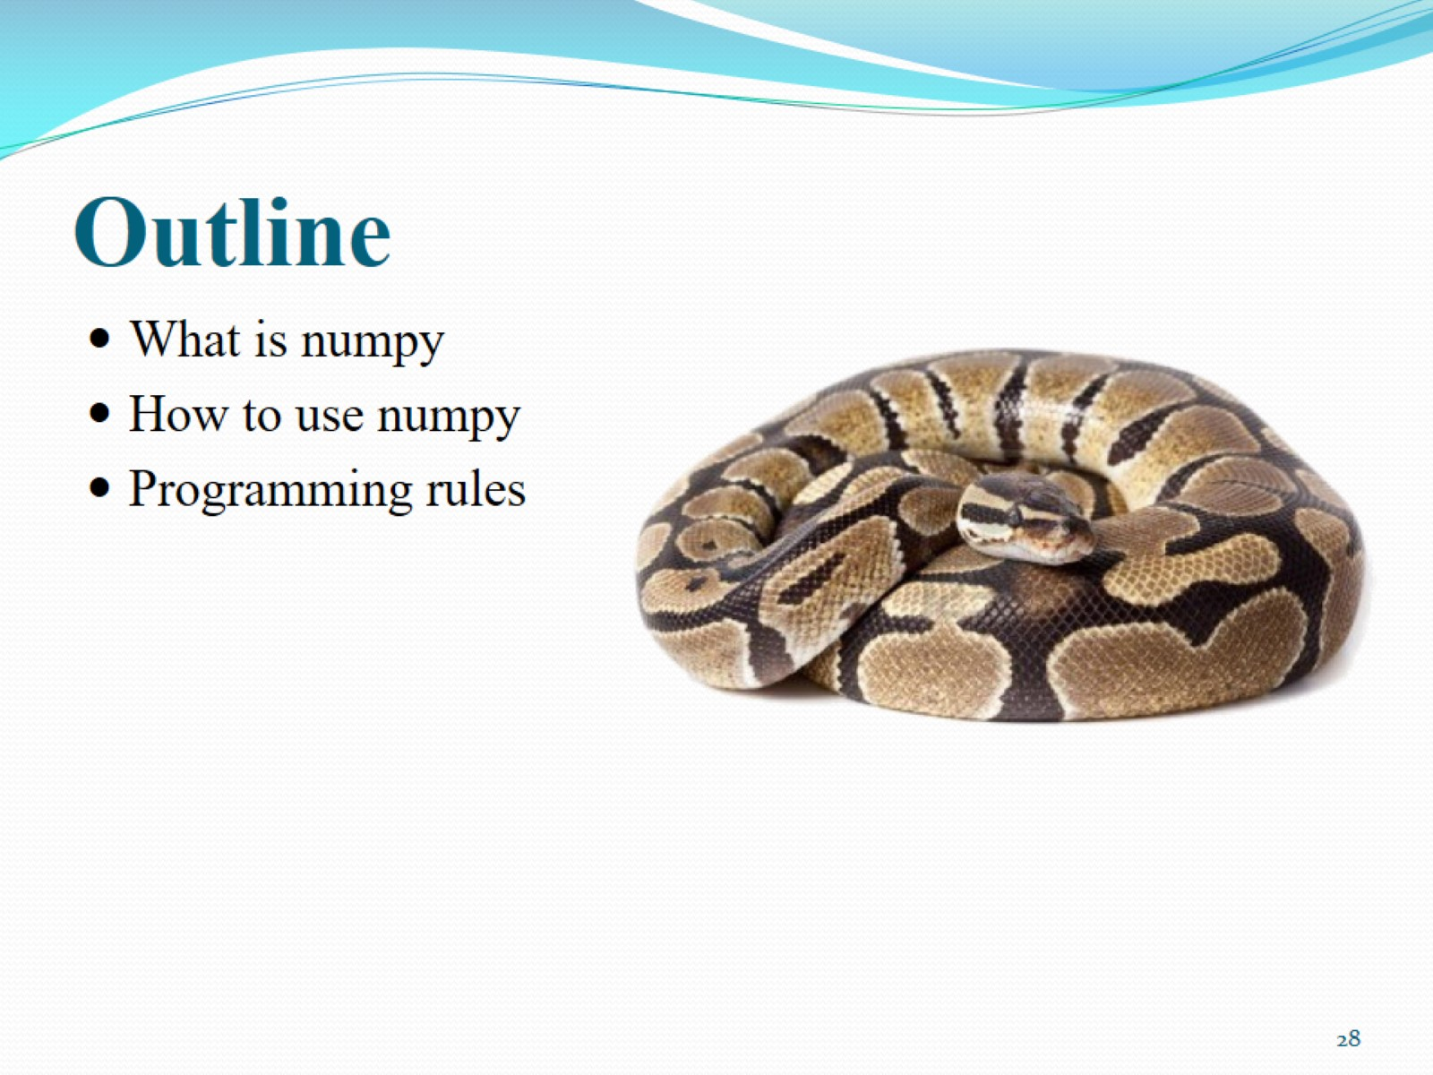
Outline

Slide 29
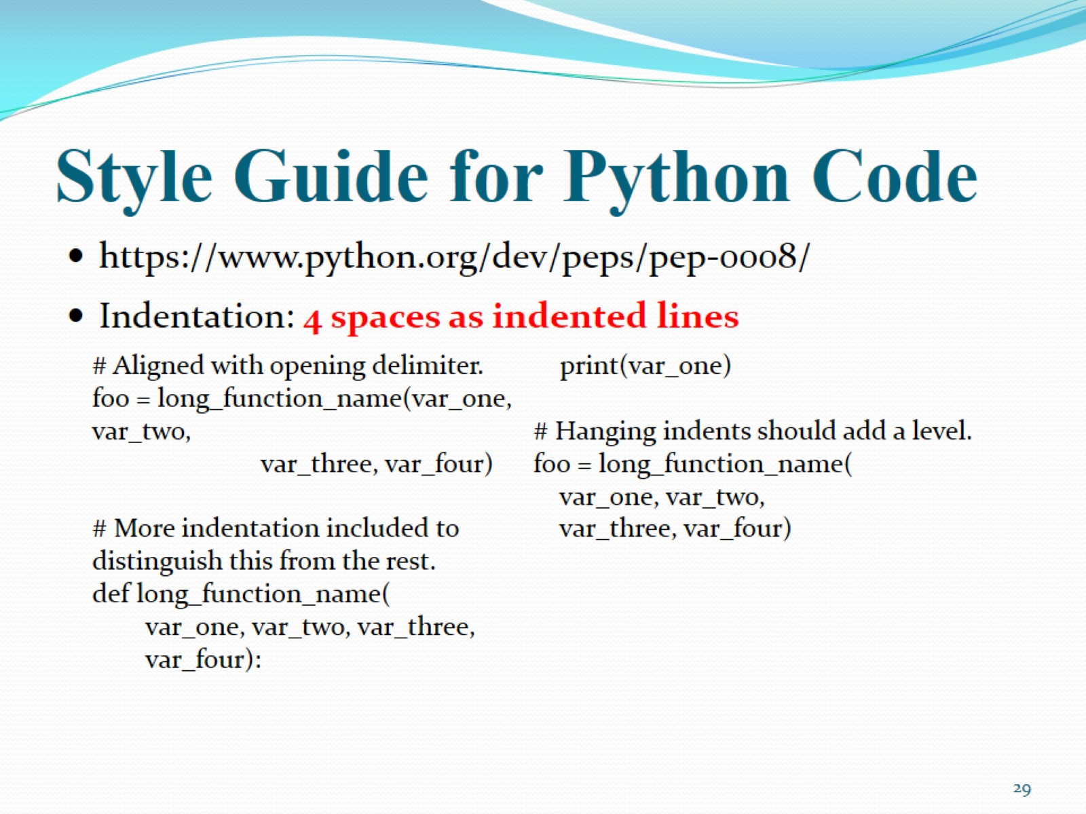
Style Guide for Python Code

Slide 30
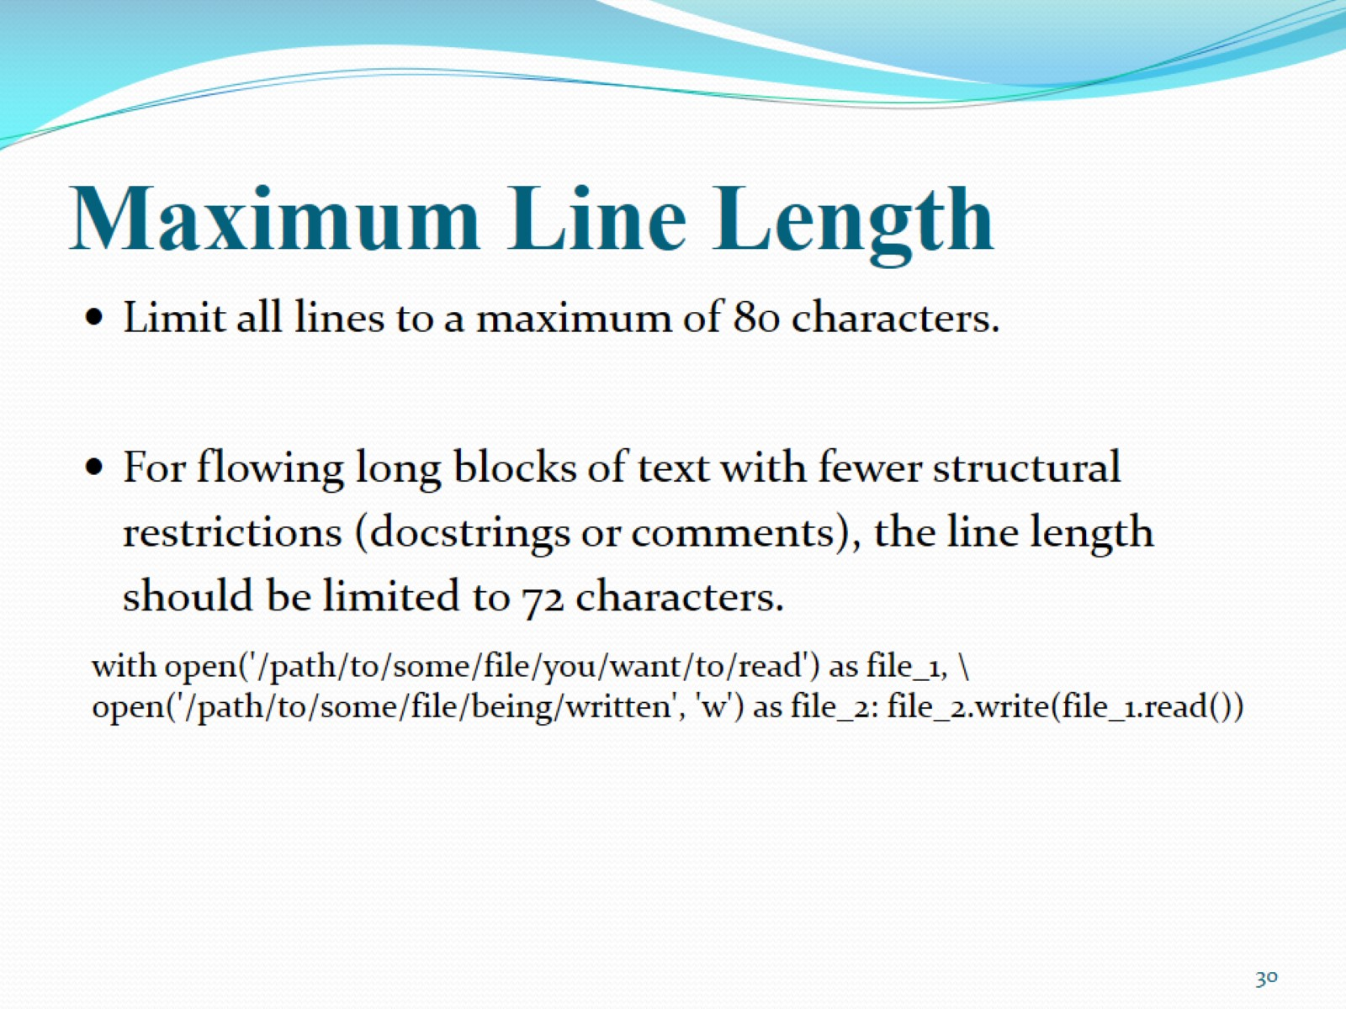
Maximum Line Length

Slide 31
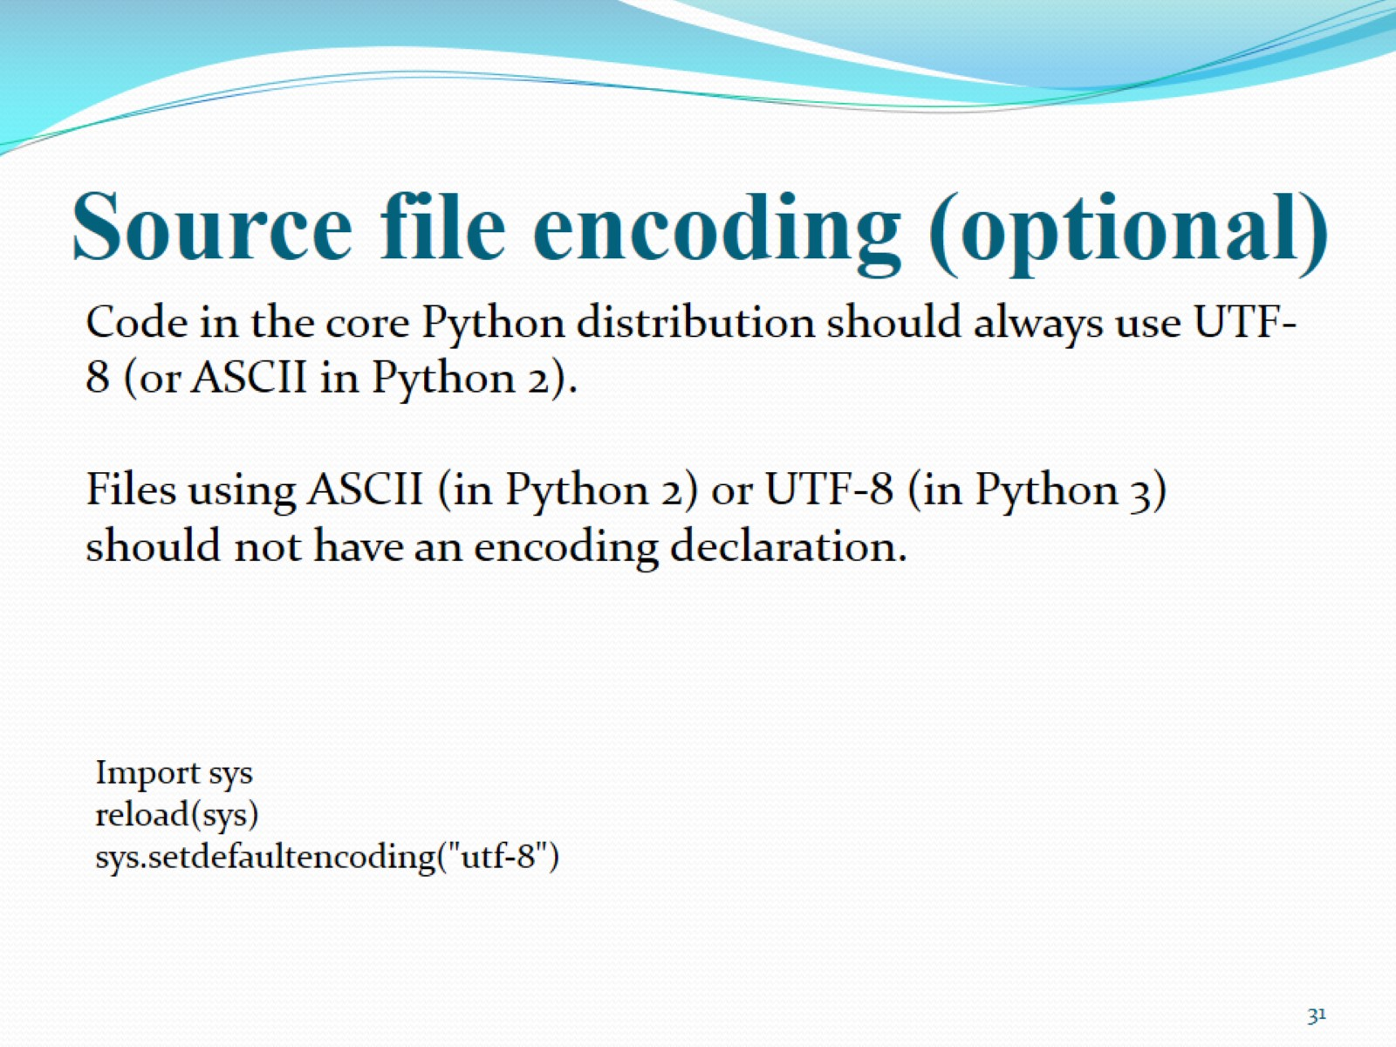
Source file encoding (optional)

Slide 32
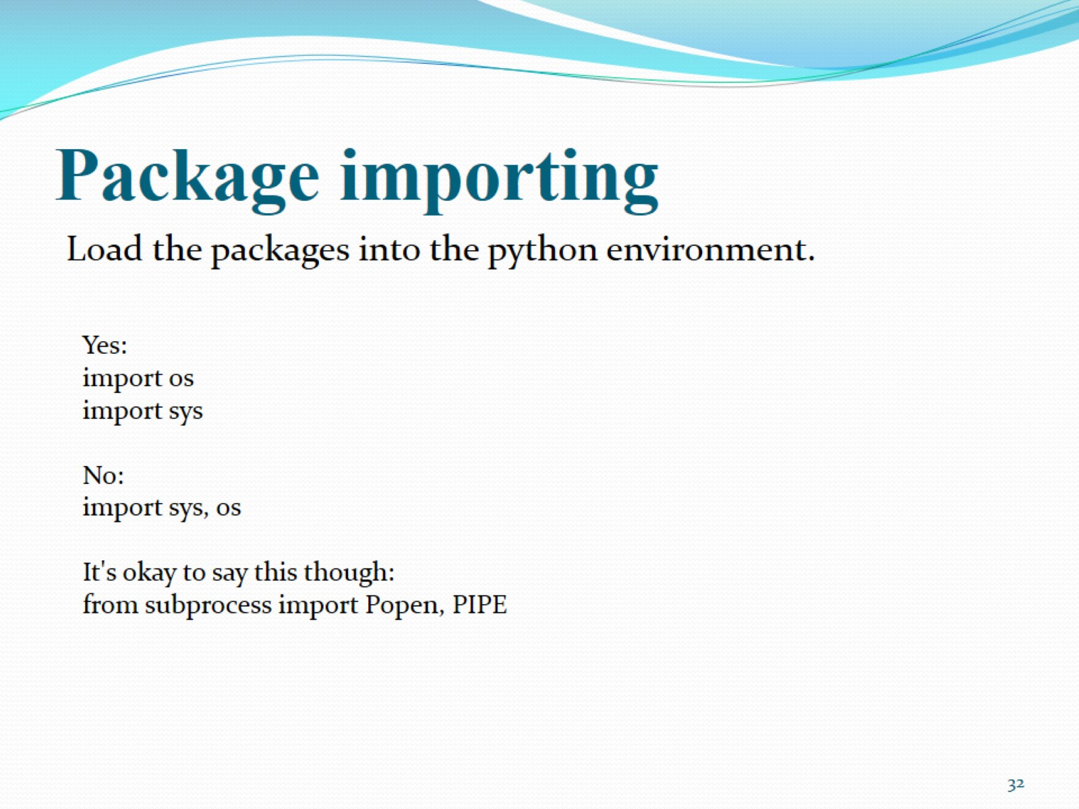
Package importing

Slide 33
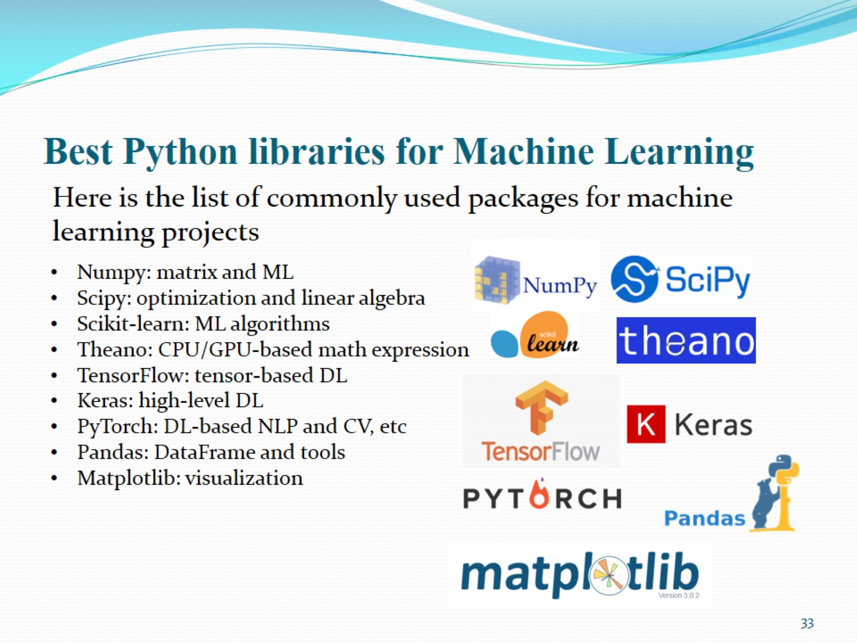
Best Python libraries for Machine Learning

